Slide 1
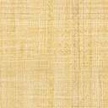

What makes a loan application more likely to be approved?
ICMM: Patrick Ma, Yunying Zhu, Zining Han

Slide 2
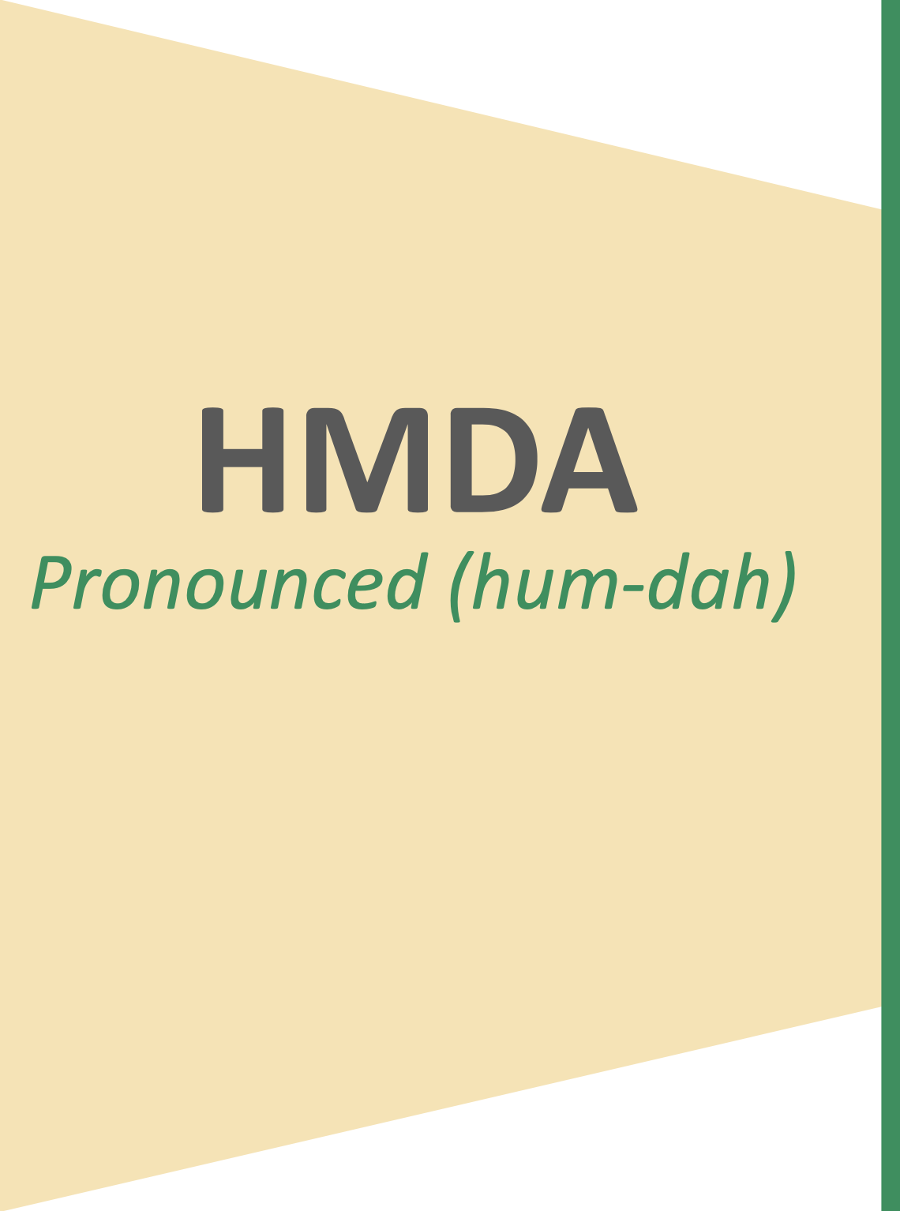
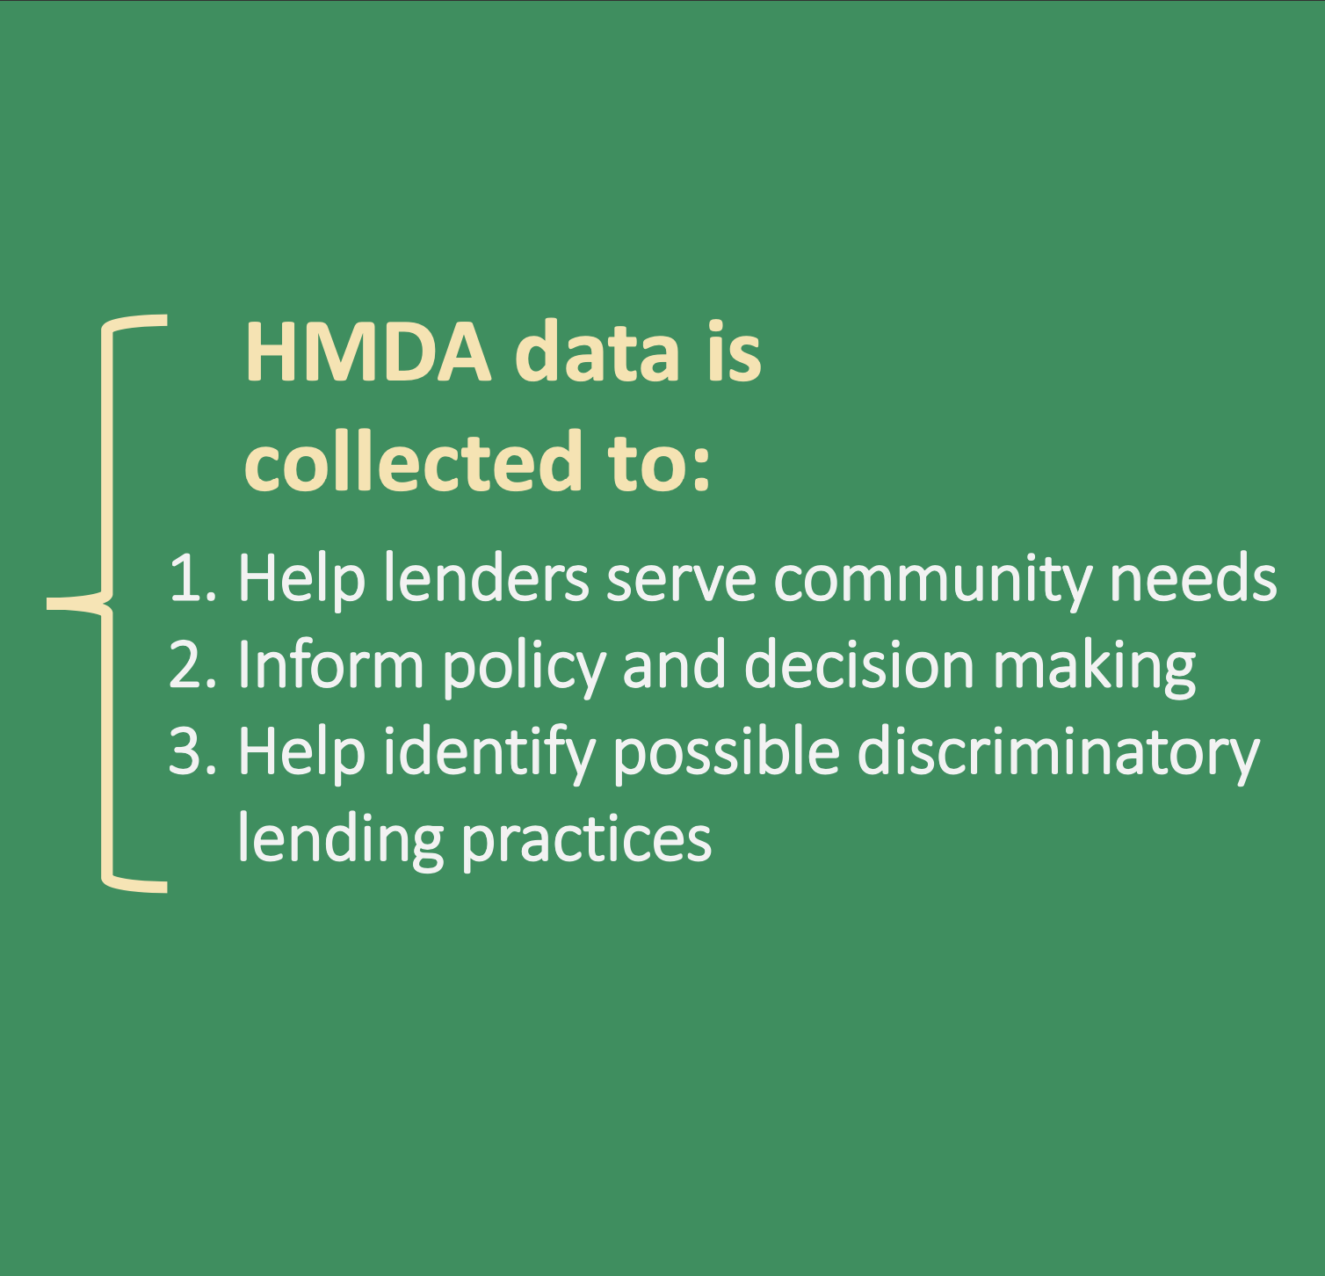

Slide 3
Background
Exploratory Data Analysis
Modeling
Conclusion and Implication
Data Cleaning

Slide 4
Data Cleaning
Deleted columns with to many NAs (e.g. applicant_race_3).
Deleted linearly dependent column (e.g. derived sex, applicant_sex, co-applicant_sex).
Deleted non-related columns (e.g. county_code)

Slide 5
Exploratory Data
Analysis

Slide 6
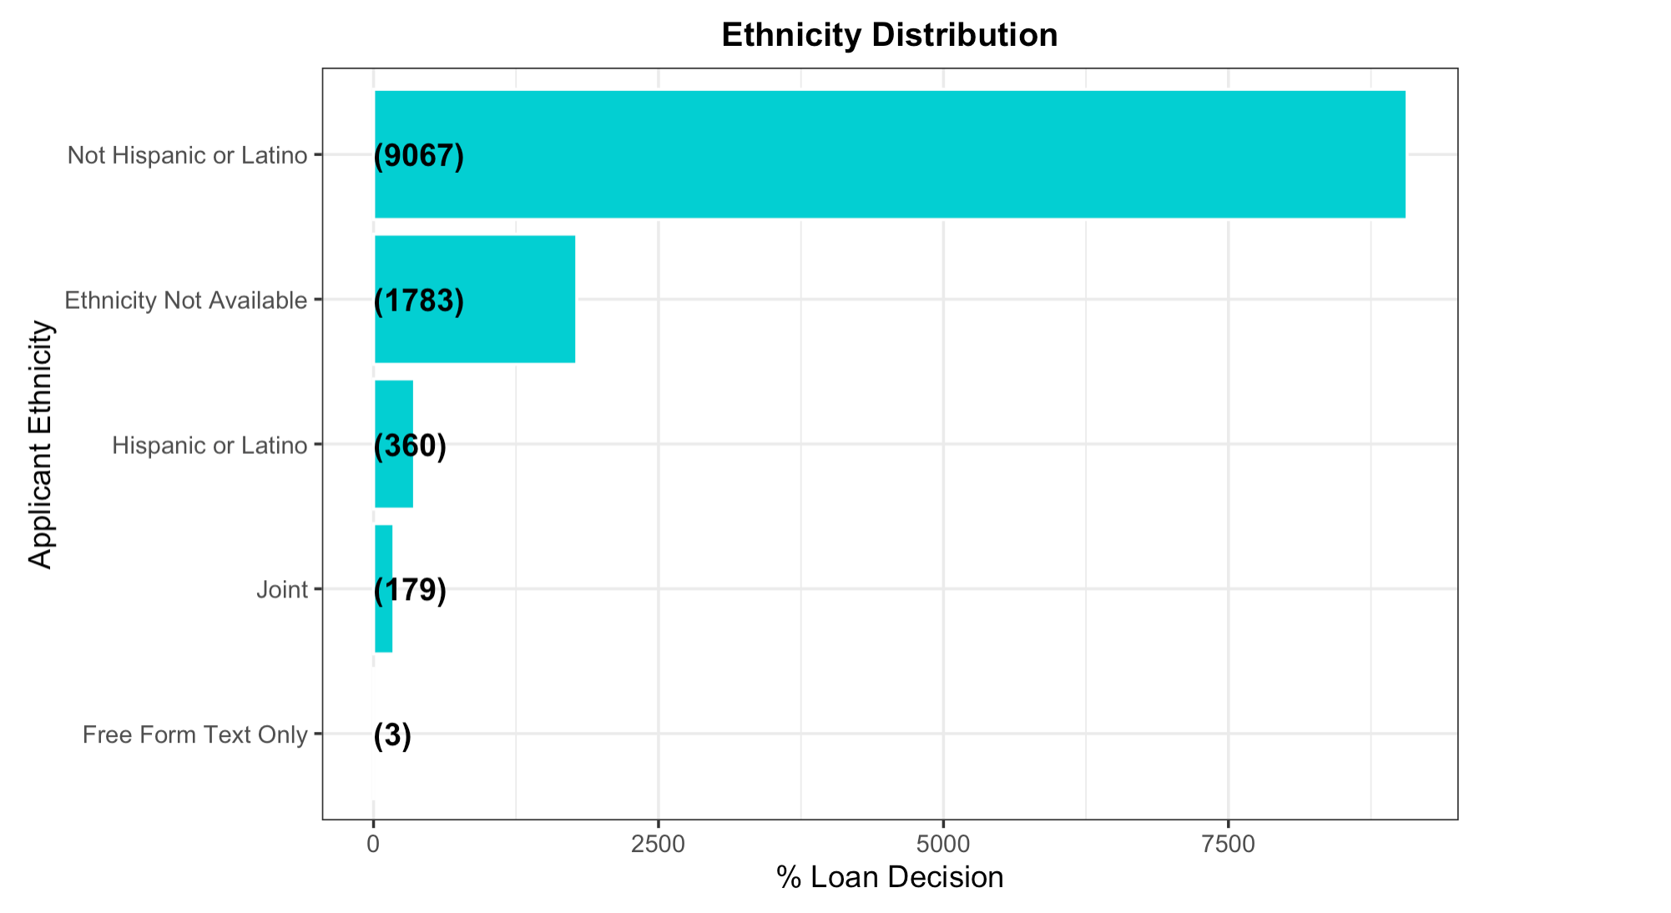

Slide 7
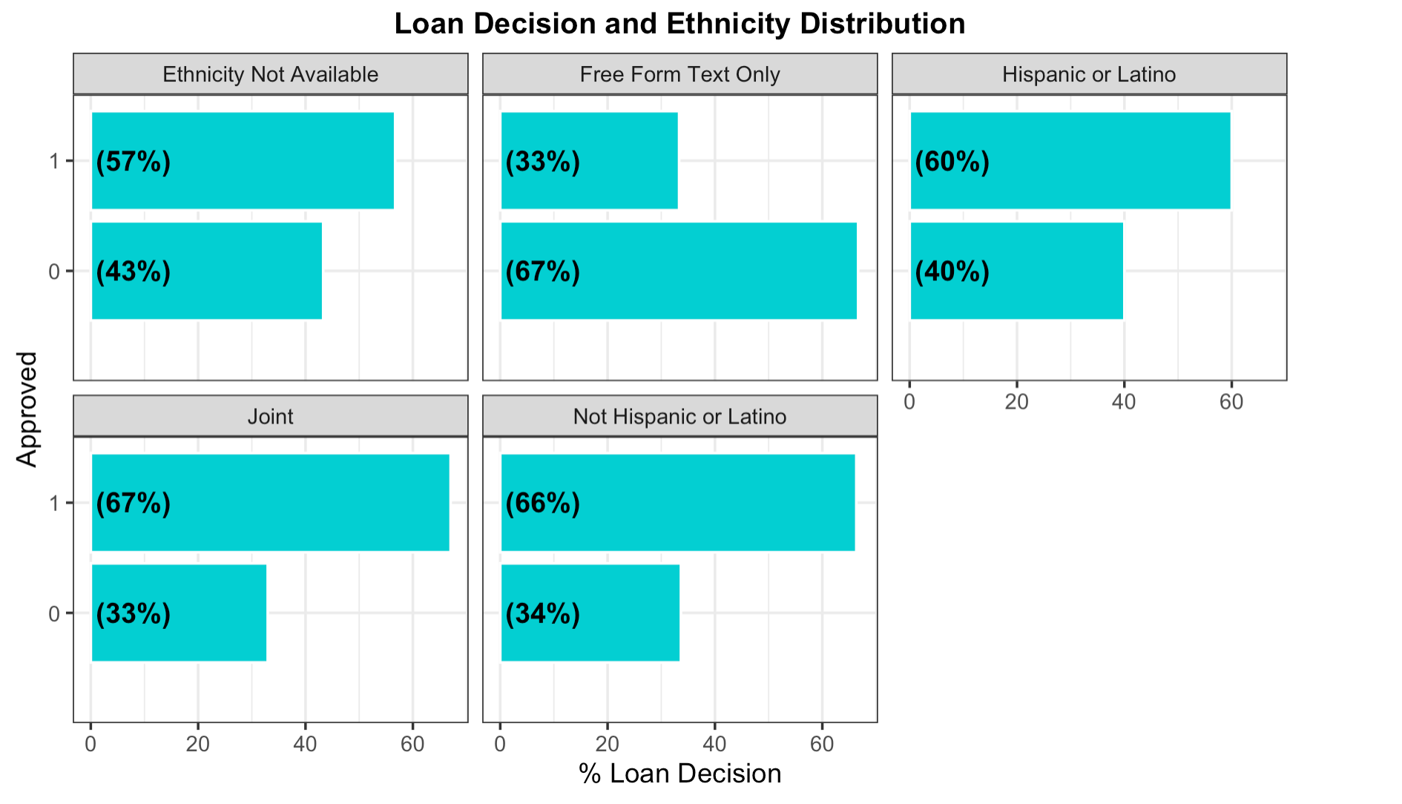

Slide 9
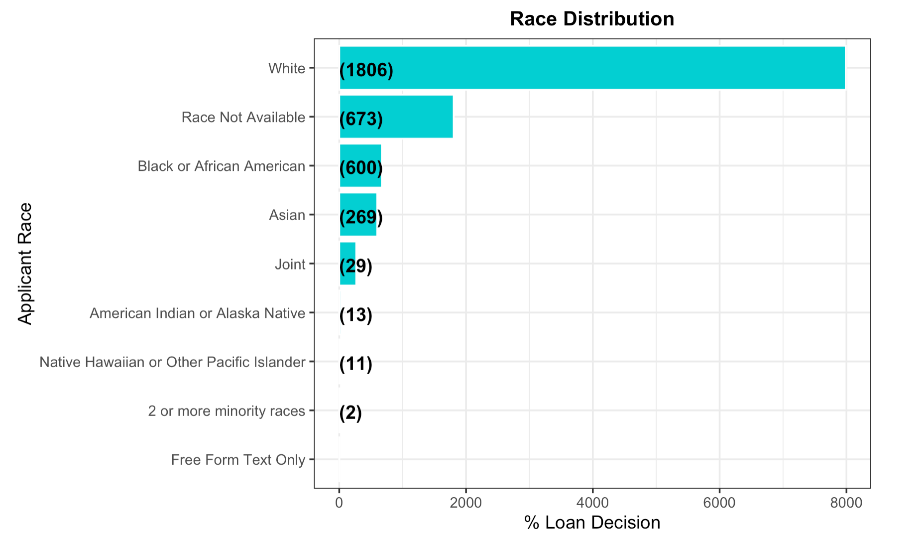

Slide 10
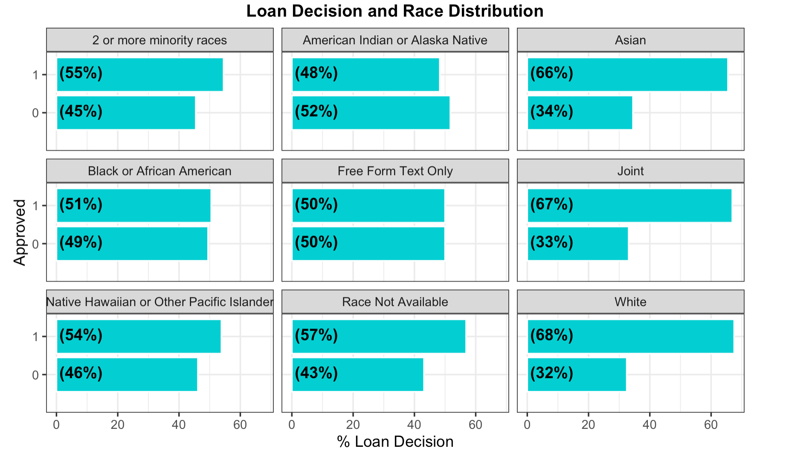

Slide 11
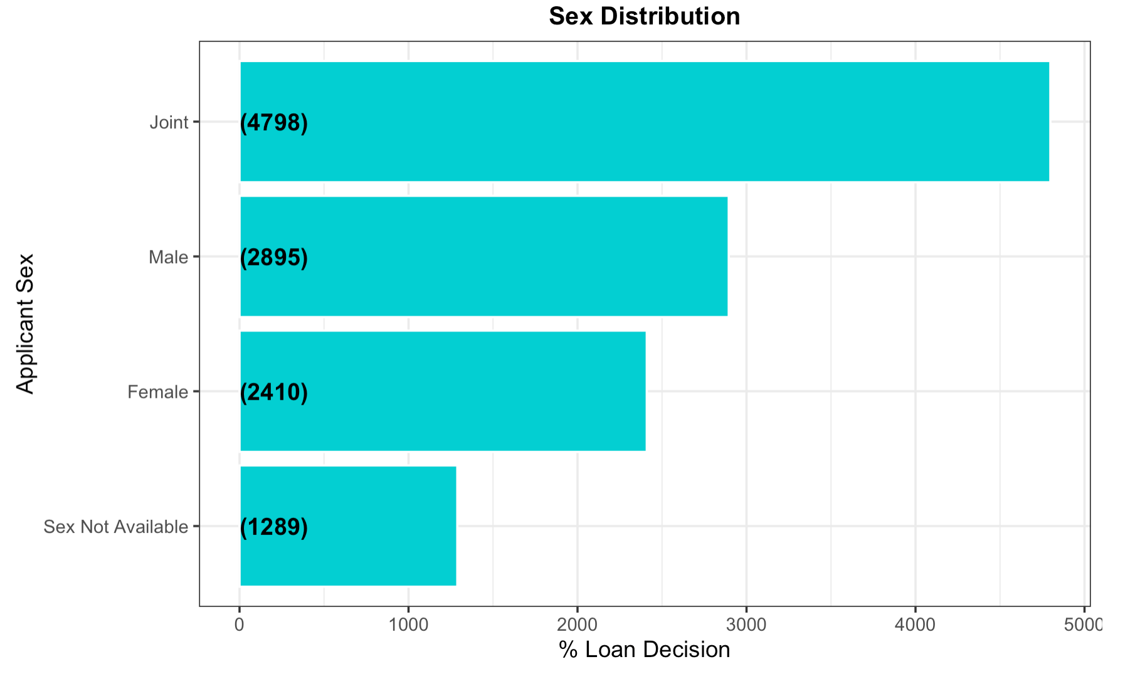

Slide 12
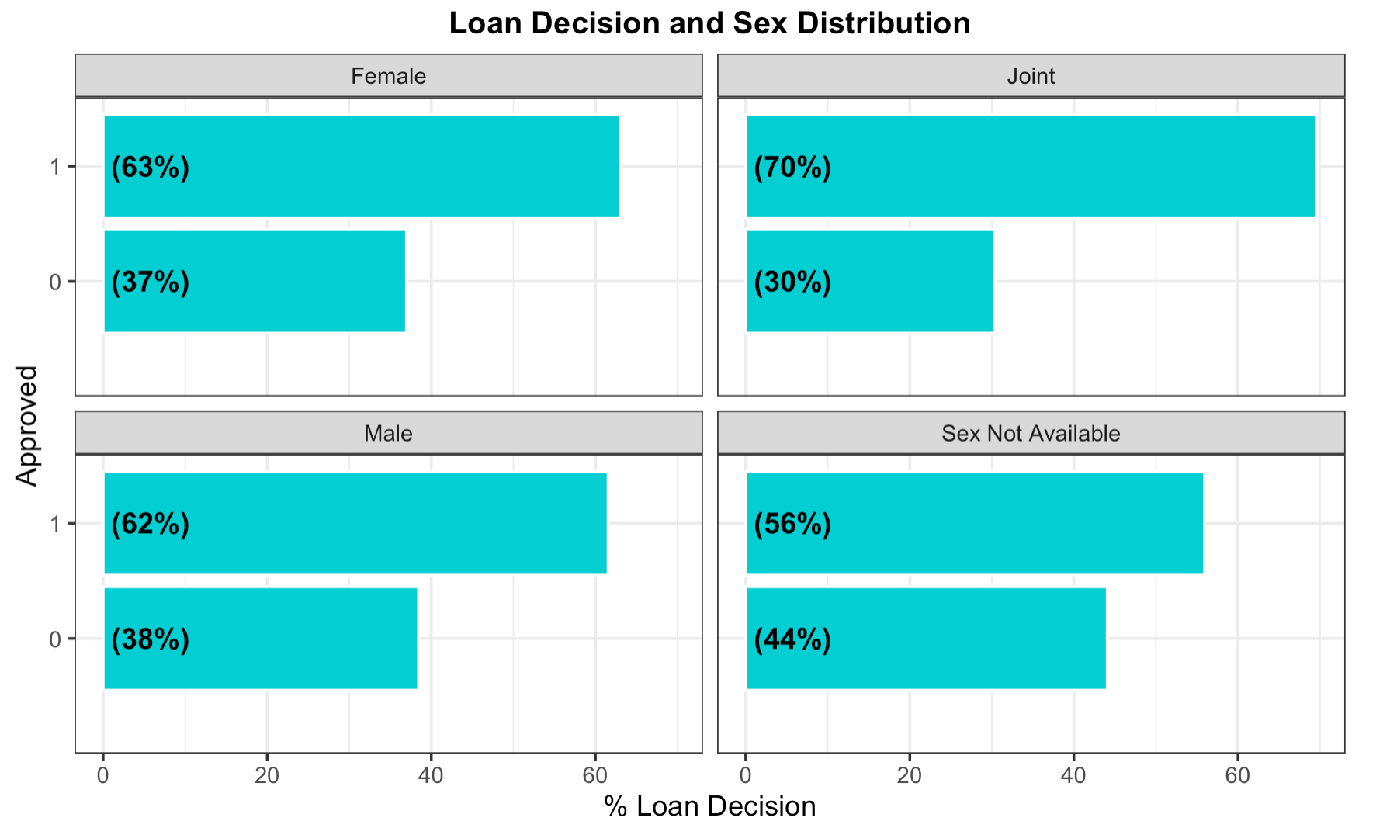

Slide 13
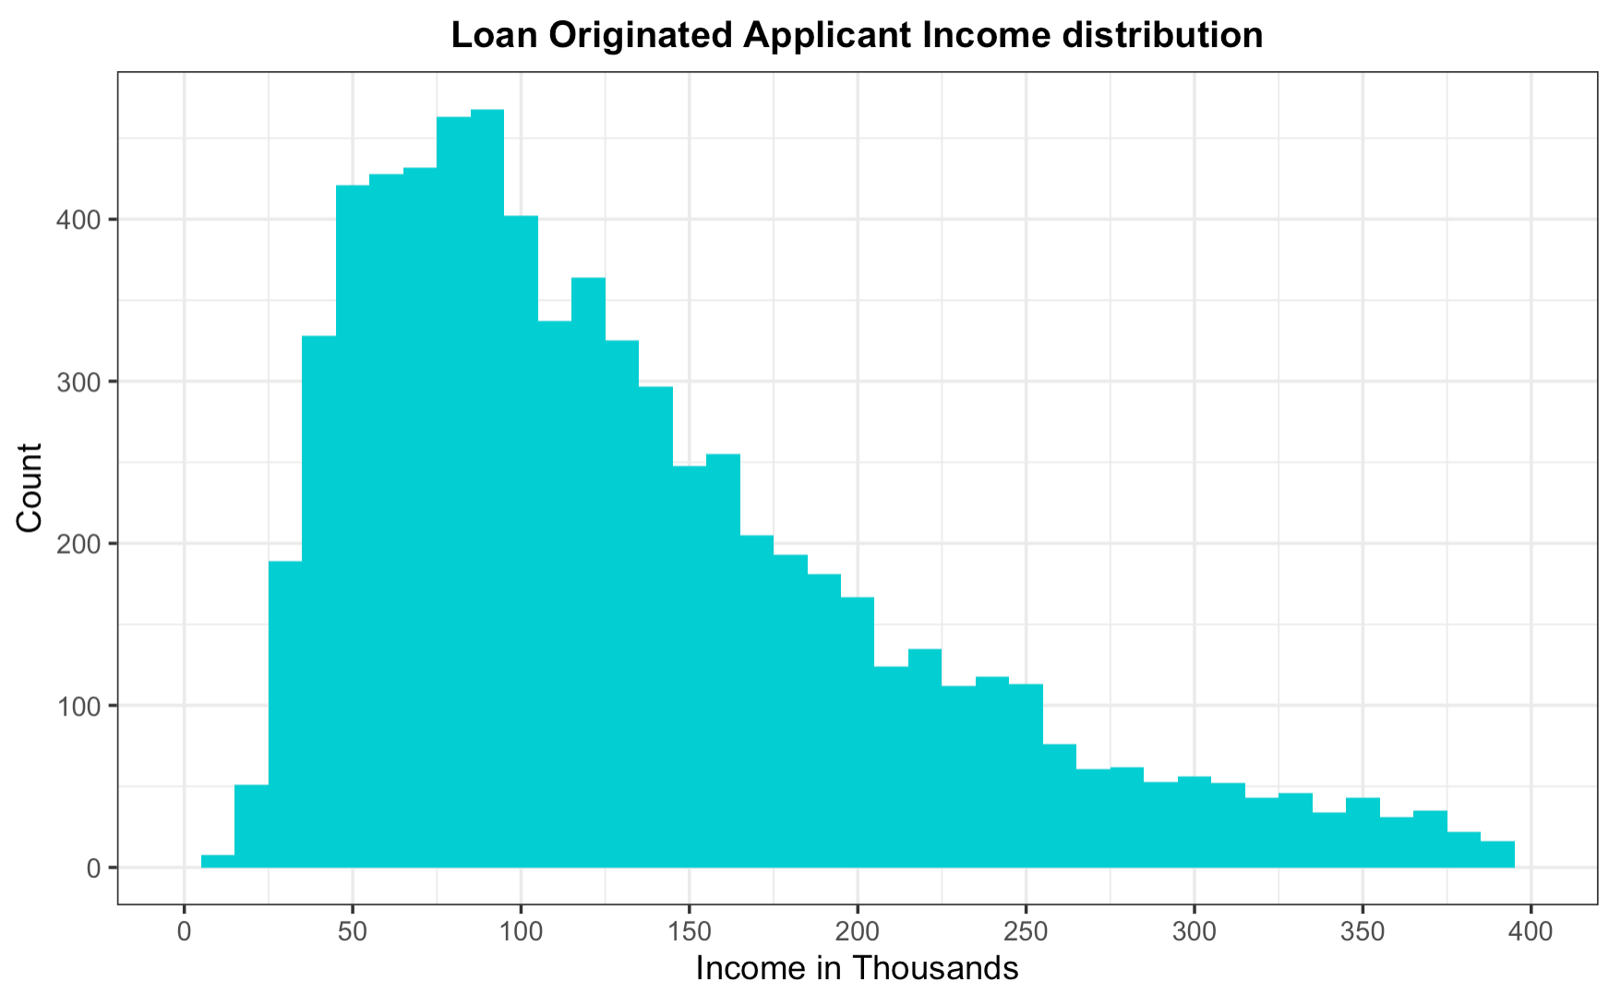

Slide 14
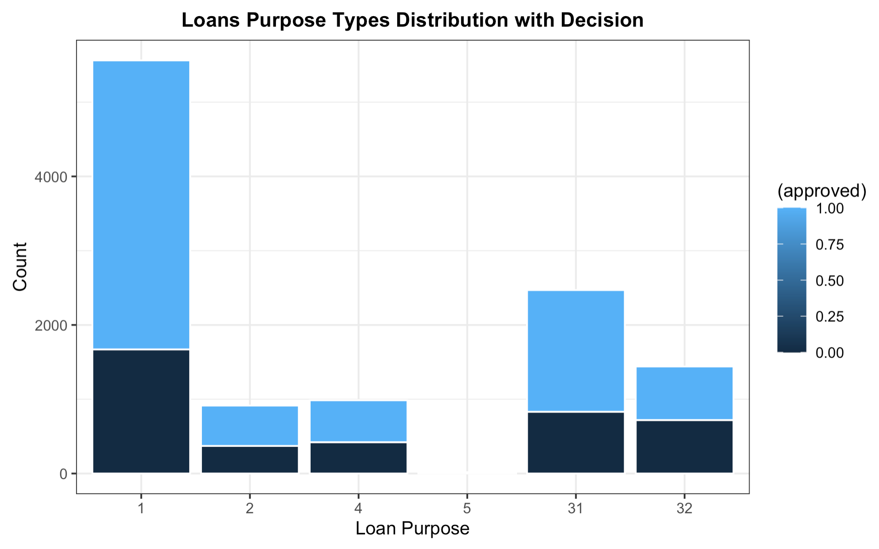
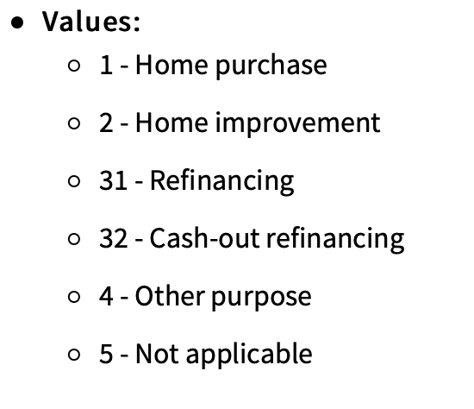

Slide 15
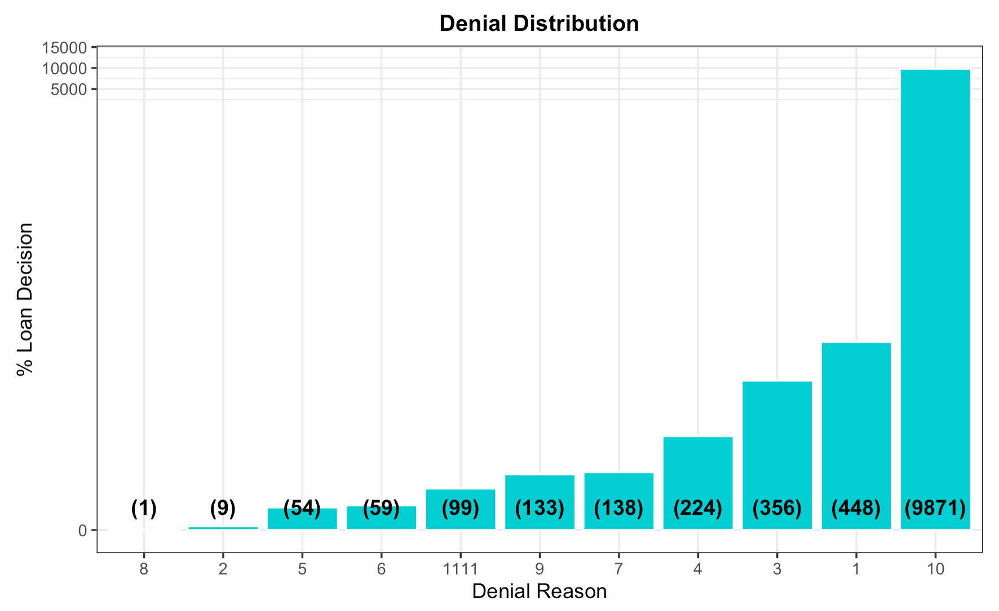
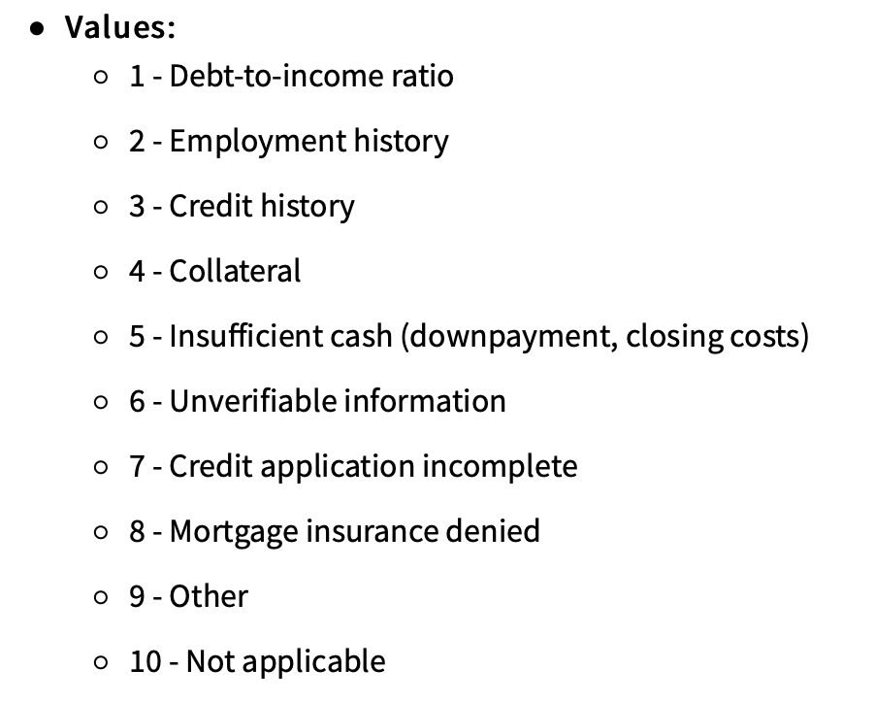

Slide 16
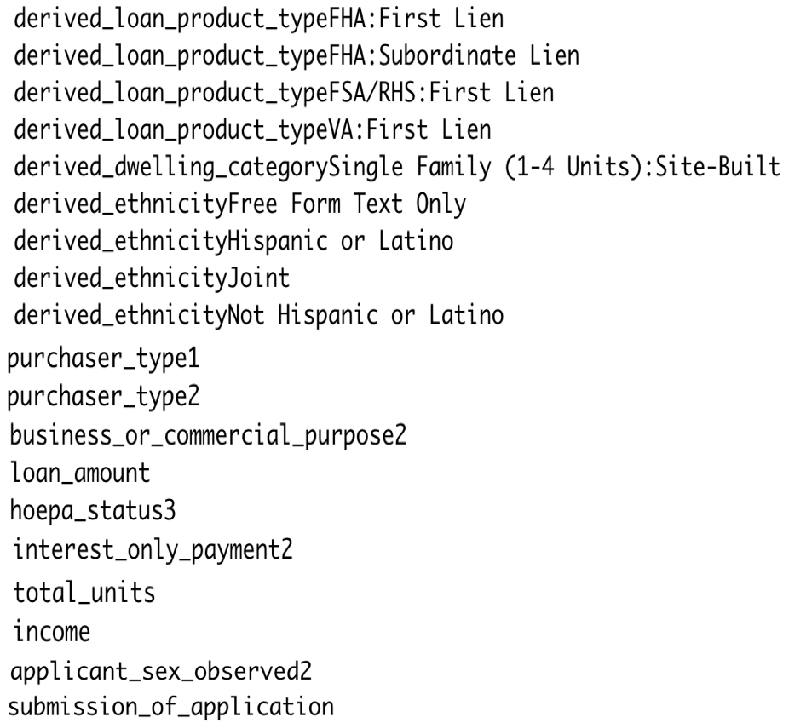
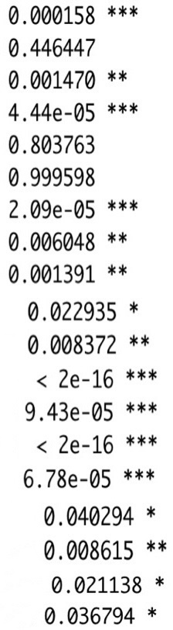
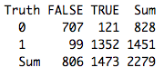
Modeling - Logistic Regression
Confusion Matrix
Accuracy for 0: 87.72%
Accuracy for 1: 91.78%

Slide 17
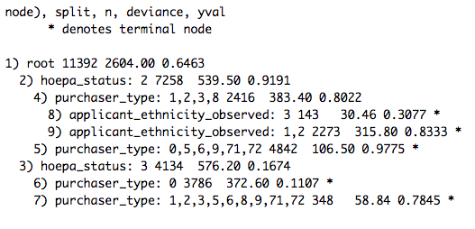
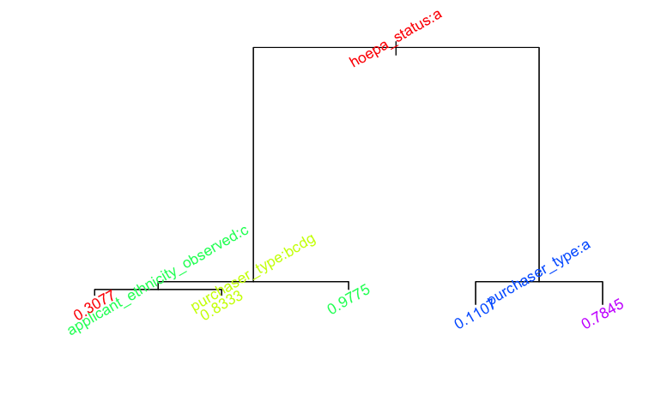
Modeling – Decision Tree

Slide 18
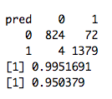
Modeling – Random forest
Confusion Matrix

Slide 19
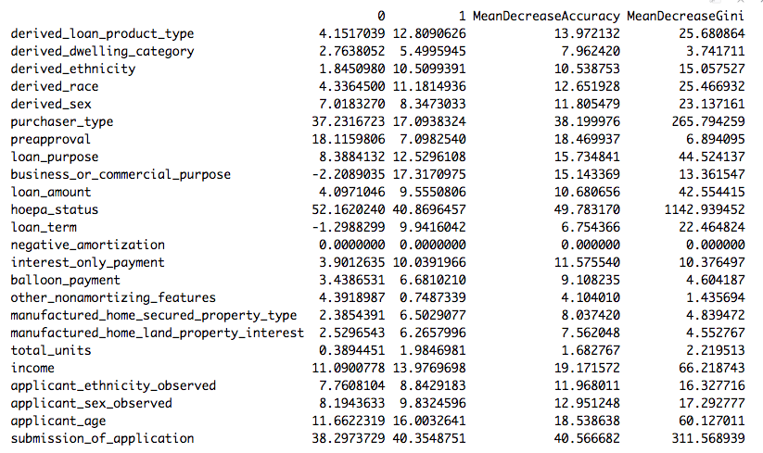
Modeling – Random forest

Slide 20
Conclusion

